Slide 1
Randomized Algorithms CS648
Lecture 11
Random sampling
Method of Bounded Difference
– Estimating a parameter

Slide 2
Recap of the previous lecture

Slide 3

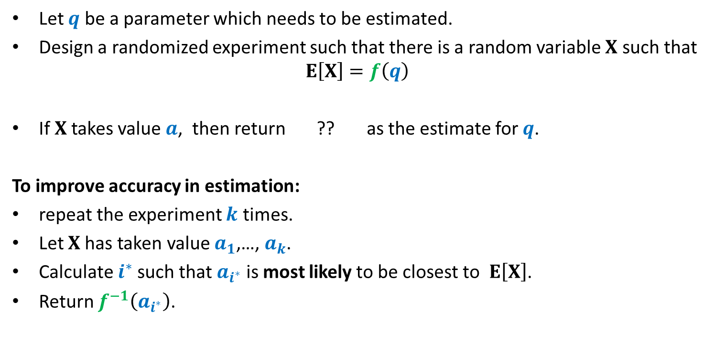
Randomized framework for estimating a parameter
Let $q$ be a parameter which needs to be estimated.
Design a randomized experiment such that there is a random variable $X$ such that
$$E\left[X\right]=f\left(q\right)$$
If $X$takes value $a$, then return ?? as the estimate for $q$.
To improve accuracy in estimation:
repeat the experiment $k$ times.
Let $X$has taken value $a_{1}$,…, $a_{k}$.
Calculate $i^{∗}$such that $a_{i^{∗}}$ is most likely to be closest to $E\left[X\right]$.
Return $f^{−1}\left(a_{i^{∗}}\right)$.
$$f^{−1}\left(a\right)$$

Slide 4
Estimating the size of Transitive Closure of a Directed Graph

Slide 5
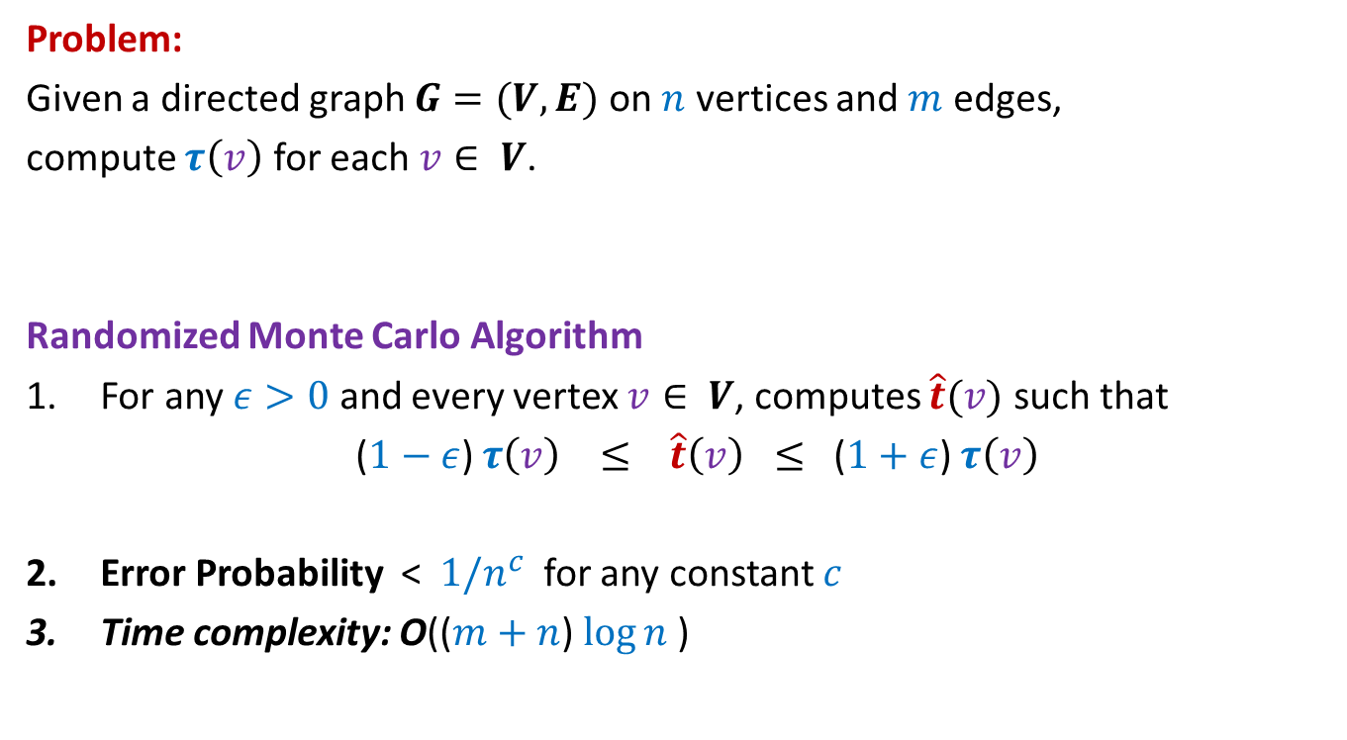
Estimating size of Transitive Closure of a Directed Graph
Problem:
Given a directed graph $G=(V,E)$ on $n$ vertices and $m$ edges,
compute $τ\left(v\right)$ for each $v∈ V$.
Randomized Monte Carlo Algorithm
For any $ε>0$ and every vertex $v∈ V$, computes $\hat{t}(v)$ such that
($1−ε$) $τ\left(v\right) ≤ \hat{t}\left(v\right) ≤$ ($1+ε$) $τ\left(v\right)$
Error Probability < $1/n^{c}$ for any constant $c$
Time complexity: O(($m+n$) $\log{n}$)

Slide 6
A problem having Deterministic Algorithms

Slide 7

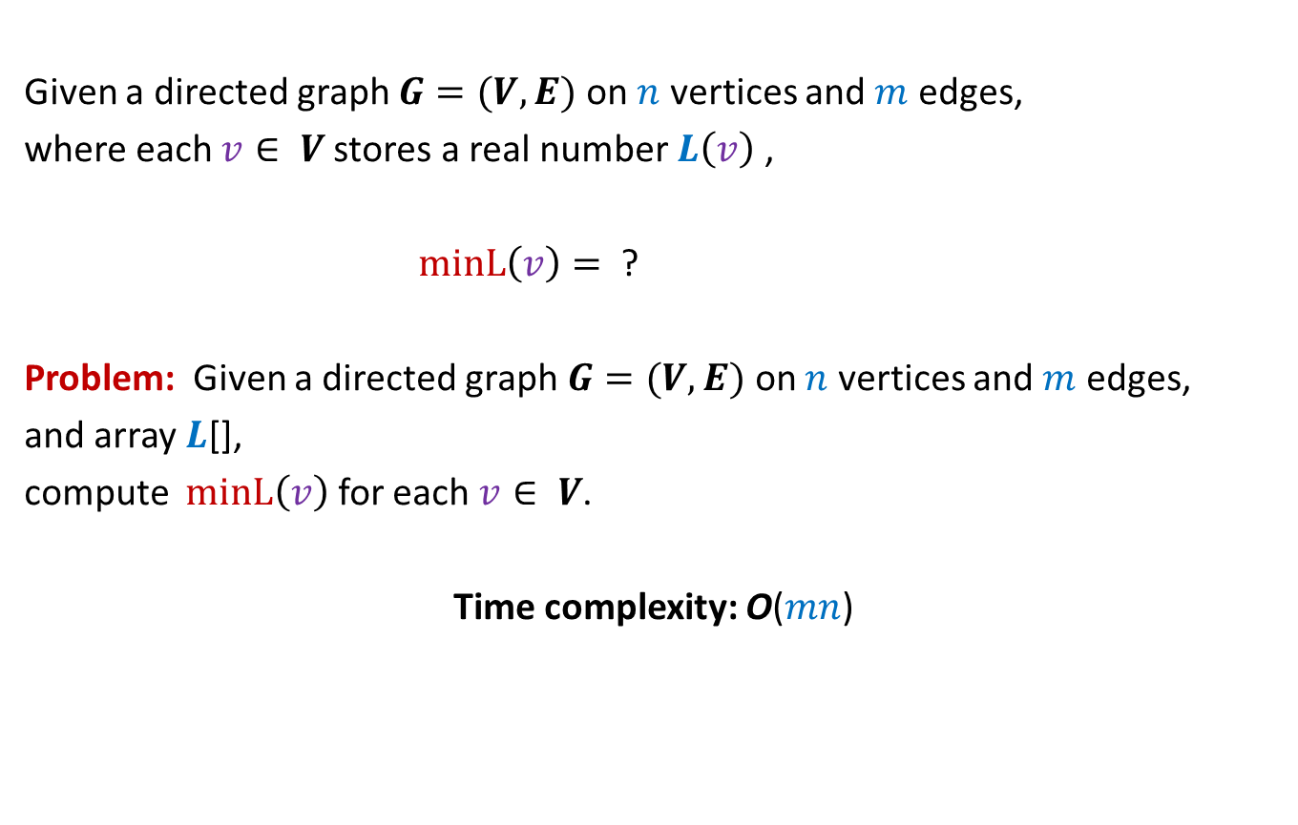

MIN-Label Problem
Given a directed graph $G=(V,E)$ on $n$ vertices and $m$ edges,
where each $v∈ V$stores a real number $L\left(v\right)$ ,
$minL\left(v\right)=$ ?
Problem: Given a directed graph $G=(V,E)$ on $n$ vertices and $m$ edges,
and array $L$[],
compute $minL\left(v\right)$ for each $v∈ V$.
Time complexity: O($mn$)
$$min\left\{L\left(x\right)\right| x \text{is} \text{reachable} \text{from} v\}$$
$$O(m+n\text{)}$$
The following two slides present two algorithms for this problem.
But, first make attempt on your own before studying these algorithms.

Slide 8


Consider the vertex of the least label
$$7.6$$
$$x$$

Slide 9
Consider the vertex of the least label
For each of these vertices, their minL value is 7.6.
$$7.6$$
$$x$$

Slide 10
Consider the vertex of the least label
For each of these vertices, their minL value is 7.6.
Remove all these vertices, and …
Proceed to the next least label vertex in the remaining graph.

Slide 11

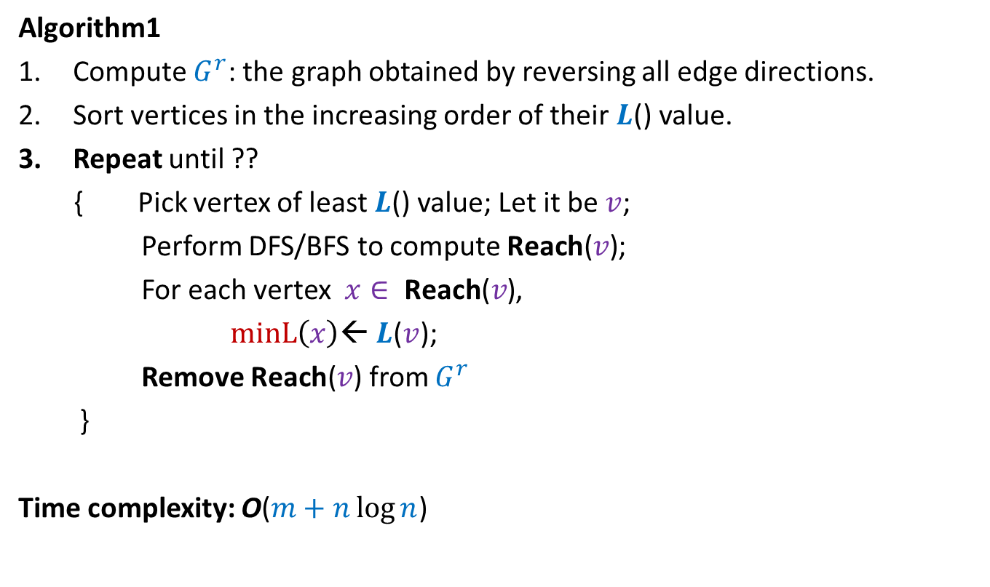
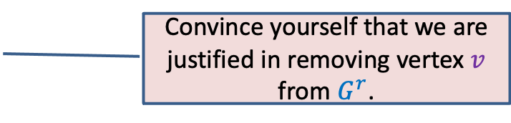
MIN-Label Problem
Algorithm1
Compute $G^{r}$: the graph obtained by reversing all edge directions.
Sort vertices in the increasing order of their $L$() value.
Repeat until ??
{ Pick vertex of least $L$() value; Let it be $v$;
Perform DFS/BFS to compute $\text{Reach}\text{(}v\text{)}$;
For each vertex $x∈ \text{Reach}\text{(}v\text{)}$,
$minL\left(x\right)$← $L$($v$);
Remove $\text{Reach}\text{(}v\text{)}$ from $G^{r}$
}
Time complexity: O($m+n\log{n}$)
$G^{r}$Is empty
Convince yourself that we are justified in removing vertex $v$ from $G^{r}$.

Slide 12
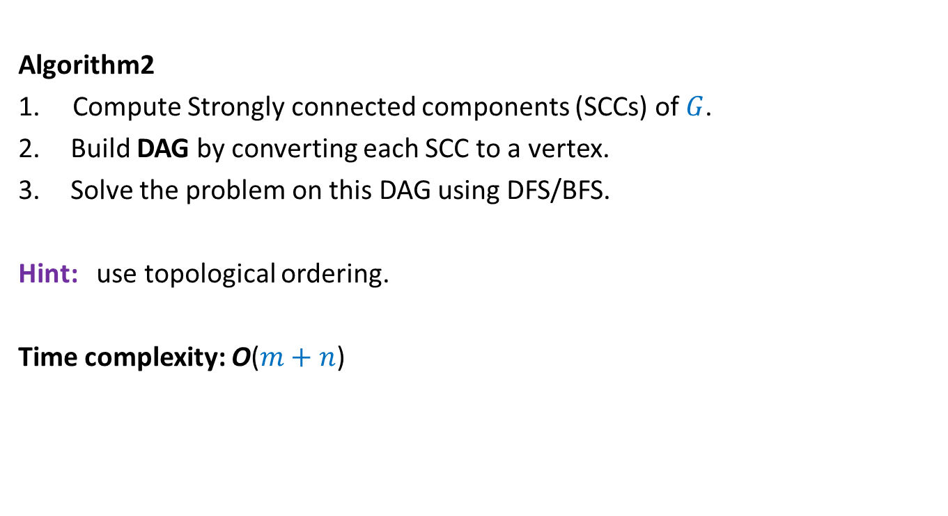
MIN-Label Problem
(Many problems are easier on Directed acyclic graphs)
Algorithm2
1. Compute Strongly connected components (SCCs) of $G$.
Build DAG by converting each SCC to a vertex.
Solve the problem on this DAG using DFS/BFS.
Hint: use topological ordering.
Time complexity: O($m+n$)

Slide 13
An inspirational problem from continuous probability

Slide 14












Sampling points on a Circle (of circumference 1)
$$X_{n}$$
Question: What is E[$X_{i}]$ ?
➔ E[$X_{1}$] $=$ E[$X_{2}$] $=$ … $=$ E[$X_{n}$]
E[$X_{1}$+$X_{2}+…X_{n}$]= ??
➔ E[$X_{1}$]= ??
$$X_{1}$$
$$X_{n−1}$$
$$X_{2}$$
$$X_{3}$$
$$X_{4}$$
Prob. distribution of $X_{i}$
$$?$$
Prob. distribution of $X_{j}$
$$1$$
$$1/n$$

Slide 15








Sampling points on a line segment
$$\frac{1}{n+1}$$
Question: What is E[$X_{i}]$ ?
Answer:
1
0
1
0
$$X_{n}$$
$$X_{n+1}$$
$$X_{1}$$
$$X_{2}$$
$$X_{3}$$
$$X_{4}$$

Slide 16
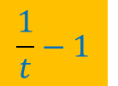
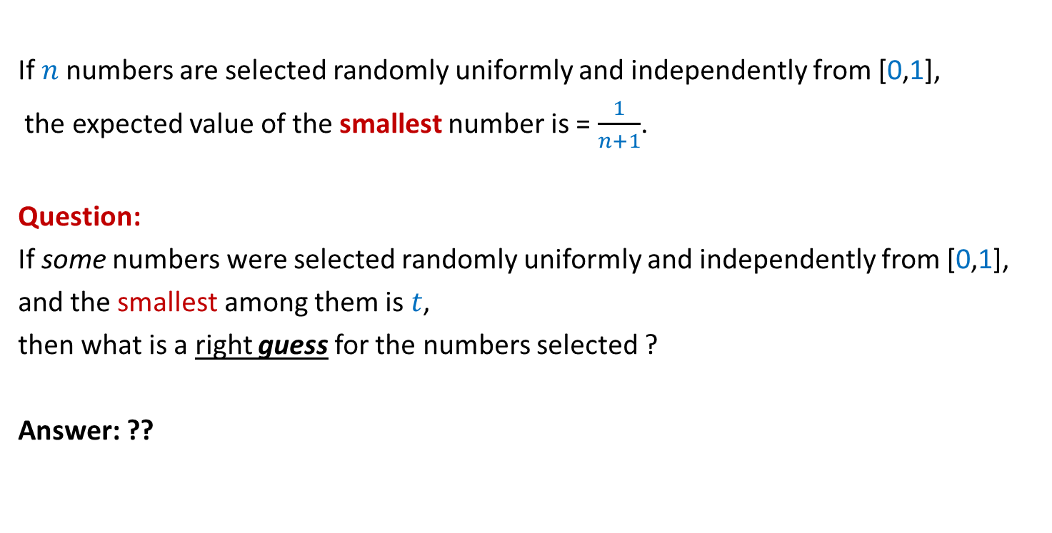
Inference from the inspirational problem
If $n$numbers are selected randomly uniformly and independently from [0,1],
the expected value of the smallest number is = $\frac{1}{n+1}$.
Question:
If some numbers were selected randomly uniformly and independently from [0,1],
and the smallest among them is $t$,
then what is a right guess for the numbers selected ?
Answer: ??
$$\frac{1}{t}−1$$
Spend some time now to design the algorithm based on this insight.

Slide 17
Randomized Monte Carlo algorithm
Estimating
the size of Transitive Closure
of a Directed Graph

Slide 18

$$x$$

Slide 19






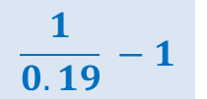

Suppose each vertex reachable from $x$ is assigned
a random no. uniformly distributed in the interval [$0,1$].
If we know the MinLabel($x$), how can we estimate $τ$($v$) ?
Can you now see the algorithm for estimating $τ$($v$) for all $v∈V$ ?
0.38
0.83
$$x$$
0.19
0.53
0.45
Estimate $\hat{τ}$($v$) :
$$\frac{1}{0.19} −1$$
$$=4.26$$
0.71
$$≈$$
$τ$($v$) :
$$=6$$

Slide 20
0.65
0.265
0.901
0.81
0.28
0.34
0.49
0.54
0.63
0.38
0.83
0.14
0.74
0.19
0.53
0.45
0.71

Slide 21
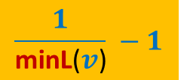
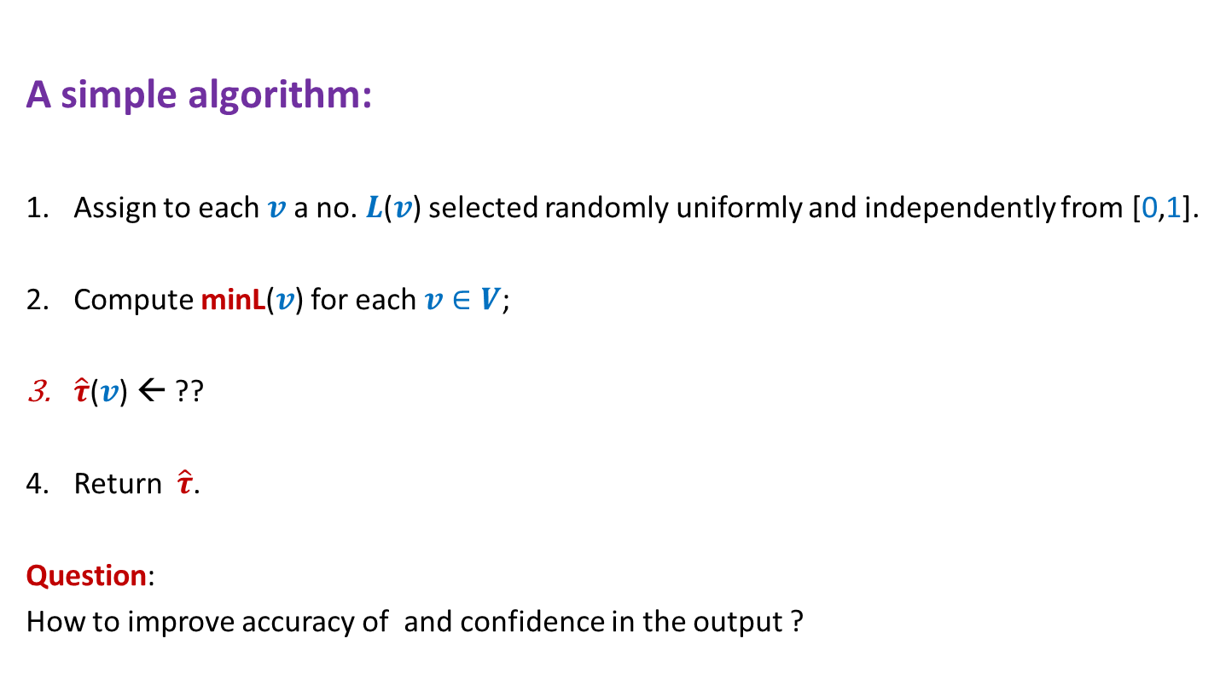
Estimating size of Transitive Closure of a Directed Graph
A simple algorithm:
Assign to each $v$ a no. $L$($v$) selected randomly uniformly and independently from [0,1].
Compute minL($v$) for each $v∈V$;
$\hat{τ}$($v$) ← ??
Return $\hat{τ}$.
Question:
How to improve accuracy of and confidence in the output ?
$$\frac{1}{\text{minL}\text{(}v\text{)}} −1$$

Slide 22
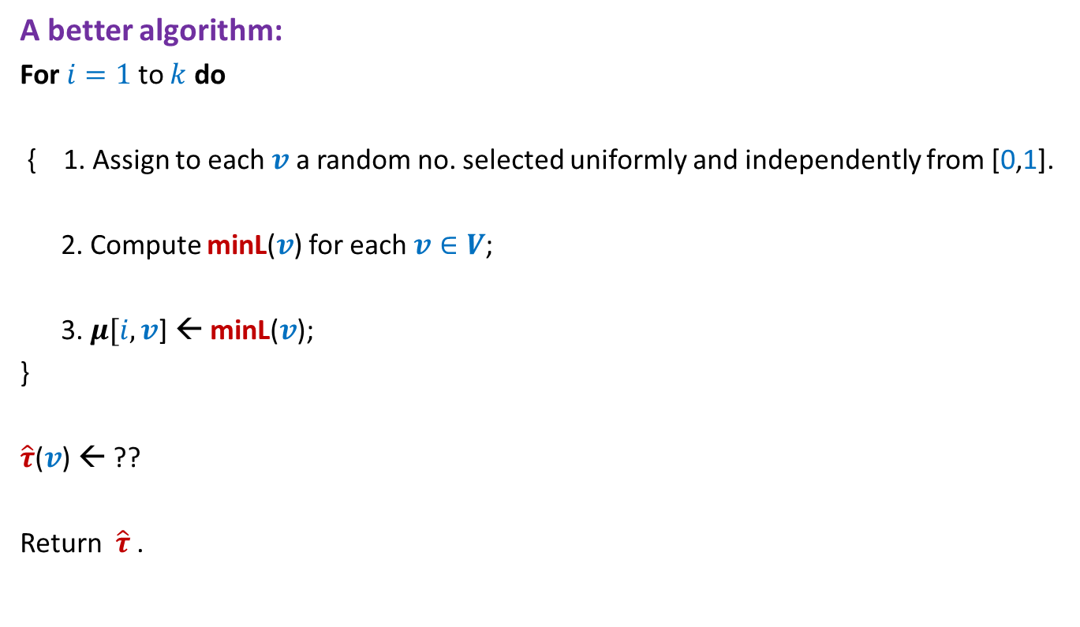
Estimating size of Transitive Closure of a Directed Graph
A better algorithm:
For $i=1$to $k$ do
{ 1. Assign to each $v$ a random no. selected uniformly and independently from [0,1].
2. Compute minL($v$) for each $v∈V$;
3. $μ[i,v$] ← minL($v$);
}
$\hat{τ}$($v$) ← ??
Return $\hat{τ}$.

Slide 23

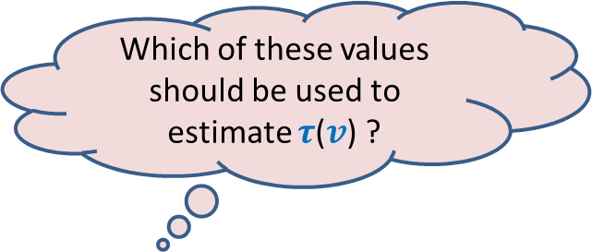

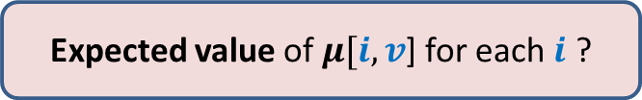
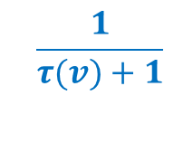
$\{μ[1,v$], $μ[2,v$], …, $μ[k,v]$}
Question 1: Which value among $\{μ[1,v$], …, $μ[k,v]$} is likely to be closest to $\frac{1}{τ(v)+1}$?
Question 2: How many of$\{μ[1,v$], …, $μ[k,v]$} are likely to have value $≥\frac{1}{τ(v)+1}$ ?
Question 3: What is the probability that $μ[i,v$] for any fixed $i$ is $≥\frac{1}{τ(v)+1}$
Which of these values should be used to estimate $τ$($v$) ?
Homework: Try to answer the above questions and complete the analysis of the algorithm.
0
1
$$\frac{1}{τ(v)+1}$$
Expected value of $μ[i,v$] for each $i$ ?

Slide 24
Method of Bounded Difference

Slide 25

Objective
$x_{1},$ $x_{2}$,…, $x_{n}$: $n$ random variables, not necessarily independent
$f$ : function of $x_{1},$ $x_{2}$,…, $x_{n}$
How to establish a good bound on P[|$f−E[f]|>t$] ?

Slide 26
Tools discussed till now
Markov’s Inequality
Chernoff bound

Slide 27
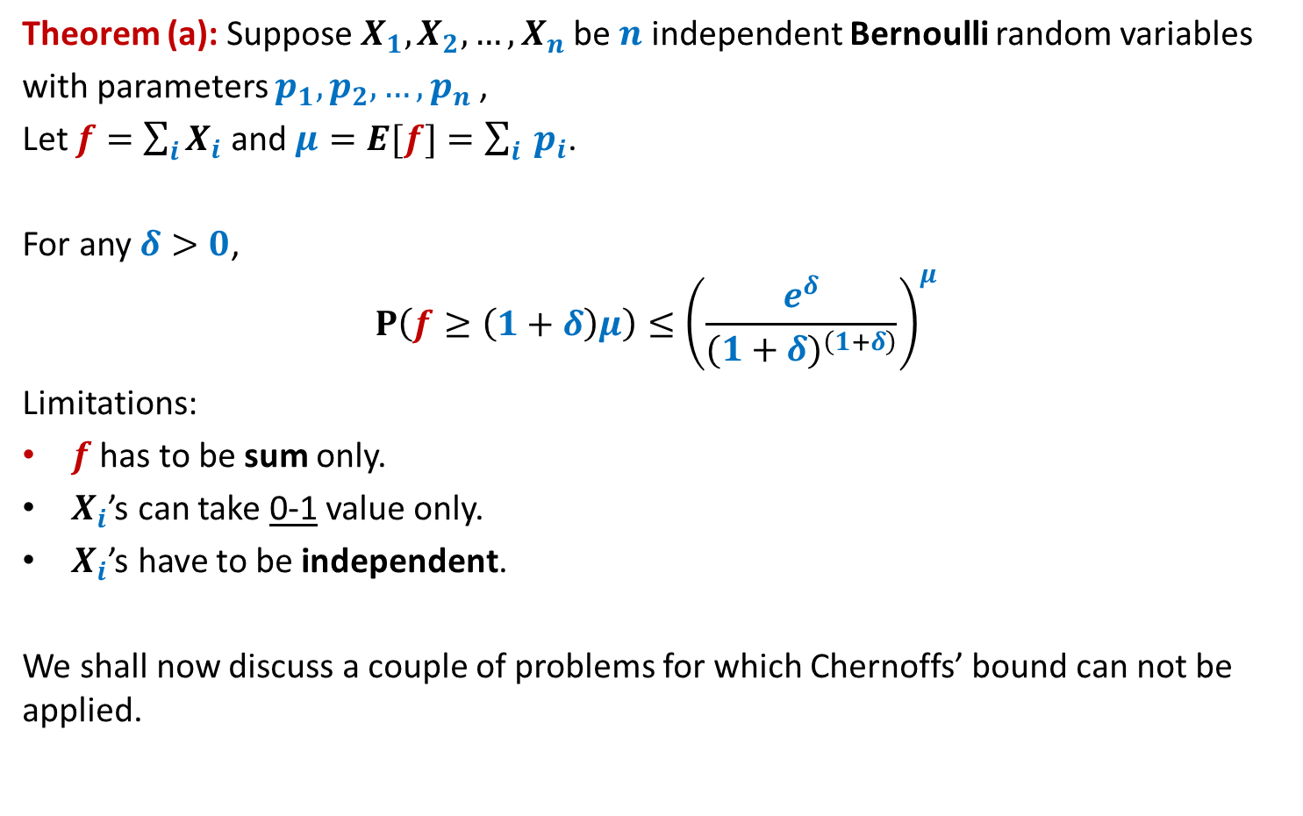
Chernoff’s Bound
Theorem (a): Suppose $X_{1},X_{2},…,X_{n}$be $n$ independent Bernoulli random variables
with parameters $p_{1},p_{2},…,p_{n}$,
Let $f=\sum_{i}{X_{i}}$ and $μ=E[f]=\sum_{i}{ p_{i}}$.
For any $δ>0$,
$$P\left(f≥\left(1+δ\right)μ\right)≤{\left(\frac{e^{δ}}{{(1+δ)}^{\left(1+δ\right)}}\right)}^{μ}$$
Limitations:
$f$ has to be sum only.
$X_{i}$’s can take 0-1 value only.
$X_{i}$’s have to be independent.
We shall now discuss a couple of problems for which Chernoffs’ bound can not be applied.

Slide 28



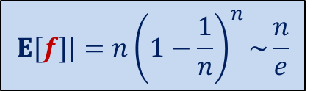

Balls into Bins
1 2 3 4 5 … $n−1 n$
$f$: number of empty bins.
: number of bins with $2$ balls.
$x_{i}$ :
1 if $i$th bin is empty
1 2 3 … $i$ … $n$
$$E[f]|=n{\left(1−\frac{1}{n}\right)}^{n}\sim \frac{n}{e}$$
P[|$f−E[f]|>t$] = ?

Slide 29





Balls Out of Bin
There is a bin containing $n$ red balls and $n$ blue balls.
Balls are taken out from the bag
$f$: number of red balls in the first $n$ draws
uniformly randomly
and without replacement.
$$E[f]=\frac{n}{2}$$
P[|$f−E[f]|>t$] =?
$x_{i}$ :
1 if $i$th ball is red.

Slide 30


The tightest analysis of Randomized Quick sort
Theorem [Colin McDiarmid, 1991]:
Prob. the run time of Randomized Quick sort exceeds average by $x\%$ = ?
$$n^{− \frac{x}{100} ln ln n}$$

Slide 31


Notations:
$X_{i}$: {$x_{1}$, $x_{2}$, …, $x_{i}$}
$A_{i}$: {$a_{1}$, $a_{2}$, …, $a_{i}$}
$X_{i}=A_{i}$ means
“$x_{1}=a_{1}\text{,}…,$ ${x_{i}=a}_{i}$”

Slide 32






A random experiment unfolding gradually
$$x_{1}$$
$$x_{1}=a_{1}$$
$$x_{2}$$
$$x_{2}=a_{2}$$
$$x_{3}$$
Quick sort
Balls out of Bin
Balls into Bin
…
$$Ω$$

Slide 33
Method of bounded difference

Slide 34






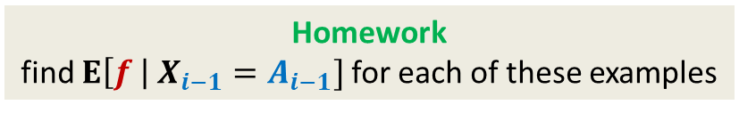
$$E[f]$$
$$x_{1}$$
$$E\left[f \right| x_{1}=a_{1}]$$
$$x_{1}=a_{1}$$
$$x_{2}$$
$$E\left[f \right| X_{2}=A_{2}]$$
$$x_{2}=a_{2}$$
$$E\left[f \right| x_{2}=a_{2},x_{1}=a_{1}]$$
…
$$E\left[f \right| X_{i−1}=A_{i−1}]$$
$$x_{i−1}=a_{i−1}$$
Balls out of Bin
Quick sort
Balls into Bin
Homework
find $E\left[f \right| X_{i−1}=A_{i−1}]$for each of these examples
$$Ω$$

Slide 35





$$E[f]$$
$$x_{1}$$
$$E\left[f \right| x_{1}=a_{1}]$$
$$x_{1}=a_{1}$$
$$x_{2}$$
$$E\left[f \right| X_{2}=A_{2}]$$
$$x_{2}=a_{2}$$
…
$$E\left[f \right| X_{i−1}=A_{i−1}]$$
$$x_{i−1}=a_{i−1}$$
$$x_{i}$$
$$E\left[f \right| X_{i−1}=A_{i−1} , x_{i}=a_{i}]$$
$$E\left[f \right| X_{i−1}=A_{i−1} , x_{i}=a_{i}′]$$
Difference < $c_{i}$
If $c_{i}$‘s are small, then probability that $f$ deviates significantly from $E[f]$
should be small.
Intuition:
$$Ω$$

Slide 36

Main theorem
Theorem:
Let $c_{1},c_{2},…,c_{n}$ be such that
for every $A_{i−1}∈X_{i−1}$, and every $a,a^{′}∈x_{i}$
$E\left[f \right| X_{i−1}=A_{i−1} , x_{i}=a]$ $−$ $E\left[f \right| X_{i−1}=A_{i−1} , x_{i}=a′]$ < $c_{i}$
Then
P[|$f−E\left[f\right]|>t$] < $2$exp$\left(−\frac{t^{2}}{2\sum_{i}{c_{i}^{2}}}\right)$

Slide 37


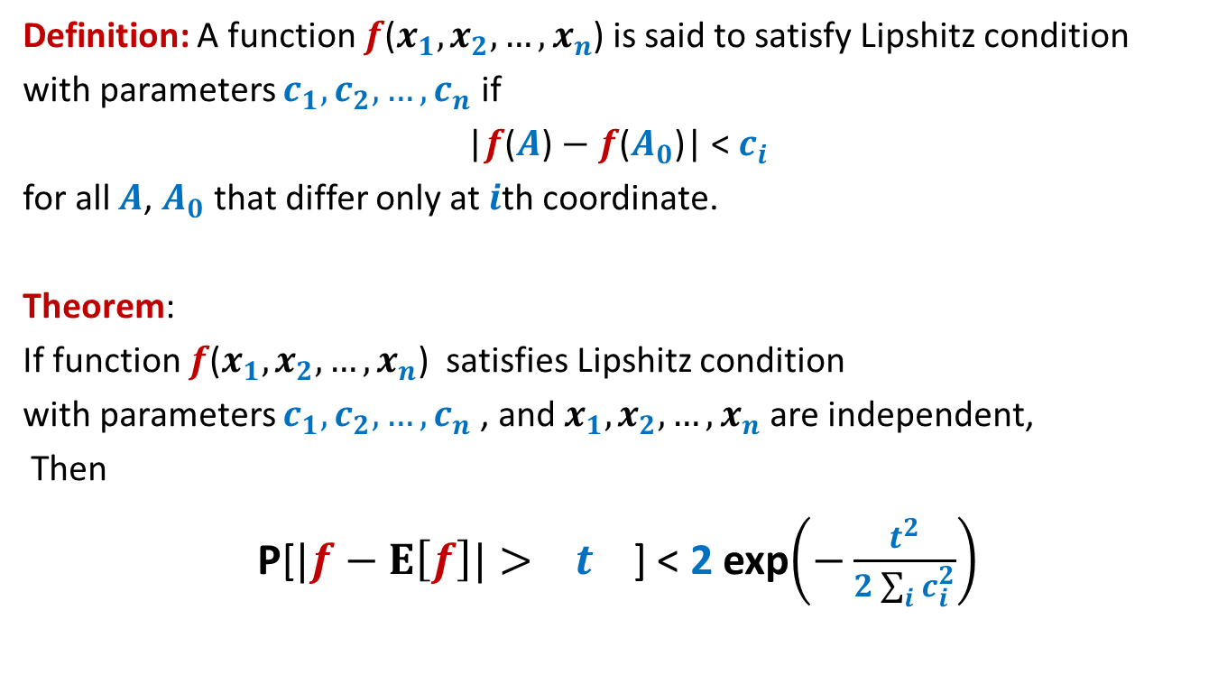


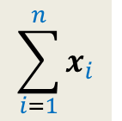

Special case theorem
Try comparing the deviation in heads in $n$ coin tosses with $t=εn$ using the above theorem and Chernoff bound.
Definition: A function $f$($x_{1},x_{2},…,x_{n}$) is said to satisfy Lipshitz condition
with parameters $c_{1},c_{2},…,c_{n}$ if
|$f$($A$) $−$ $f$($A_{0}$)| < $c_{i}$
for all $A$, $A_{0}$ that differ only at $i$th coordinate.
Theorem:
If function $f$($x_{1},x_{2},…,x_{n}$) satisfies Lipshitz condition
with parameters $c_{1},c_{2},…,c_{n}$, and $x_{1},x_{2},…,x_{n}$ are independent,
Then
P[$|f−E\left[f\right]|> t$] < 2 exp$\left(−\frac{t^{2}}{2\sum_{i}{c_{i}^{2}}}\right)$
$$E\left[f\right]$$
$x_{i}∈\{0,1\}$
2 exp$\left(−\frac{{\left(E\left[f\right]\right)}^{2}}{2n}\right)$
$$\sum_{i=1}^{n}{x_{i}}$$
$f$($x_{1},x_{2},…,x_{n}$) =
This theorem subsumes the Chernoff’s bound. ☺

Slide 38
Applications of
Method of bounded difference

Slide 39




Balls into Bins
1 2 3 4 5 … $n−1 n$
$f$: number of empty bins.
$x_{i}$ :
P[|$f−E\left[f\right]|>t$] < 2 exp$\left(−\frac{t^{2}}{2\sum_{i}{c_{i}^{2}}}\right)$
For $t=εn$
1 2 3 … $i$ … $n$
Label of the destination bin for $i$th ball.
$f$($x_{1},x_{2},…,x_{n}$) satisfies Lipshitz condition
with parameters $c_{i}=1$,
$\frac{ε^{2}}{2}n$

Slide 40




Balls Out of Bin
There is a bin containing $n$ red balls and $n$ blue balls.
Balls are taken out from the bag
$f$: number of red balls in the first $n$ draws
$x_{i}$ :
uniformly randomly
and without replacement.
First $n$ balls
First $i−1$ balls
Label of the ball picked during $i$th draw.
$|E\left[f \right| X_{i−1}=A_{i−1} , x_{i}=a]$ $−$ $E\left[f \right| X_{i−1}=A_{i−1} , x_{i}=a′]|$ = ?
Homework: Proceed from here ...

